Slide 1

INTRODUCTION TO DATA SCIENCE AND MACHINE LEARNING

Slide 2
Welcome!!
AGENDA OF THE TRAINING
In this course we will try to get essence and insights of data science or to be more specific machine learning.
We will cover Basics of Python, tool used for data science, different libraries needed for machine learning and at last we will solve a classification problem.

Slide 3


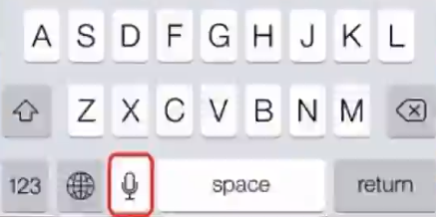
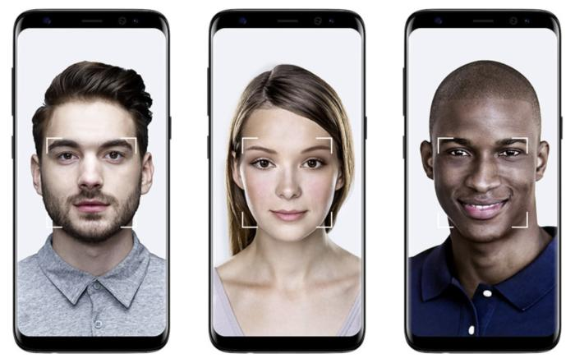


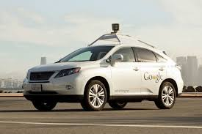
Application of ML

Slide 4
Prerequisites
Very basic knowledge of any programing language.
C/C++, java or even pl/sql will work.
Basic linear algebra(linear equations)
Knowledge of Mathematics of high school level will work.
If you are familiar with python, then great else Don’t worry!
If you are not satisfying any of above criteria, No issues, it will not create any problem in understanding this course but for future you will be needing it!!

Slide 5
Enablement for you after taking this course
You will apply this understanding in your current project and try to find any pain areas which can be solved using ML.
You will try more complex problems to dig deeper in this field as it is evolving day by day.

Slide 6
Course Overview
Why Python
Tools and installation
A Word on Jupyter Notebook
Python
Understanding Different Terminologies
Machine Learning
Types Of Machine Learning
Supervised Learning
Data Science Project Cycle
Data Pre Processing
Missing Values
Outliers
Categorical Features
Feature Engineering.
Algorithms
Cross Validation
K-fold cross validation
Normalization (Advance)
Metrics
Under & Over Fitting (Advance)
Regularization (Advance)
Hyper Parameter (Advance)
Visualizations

Slide 7
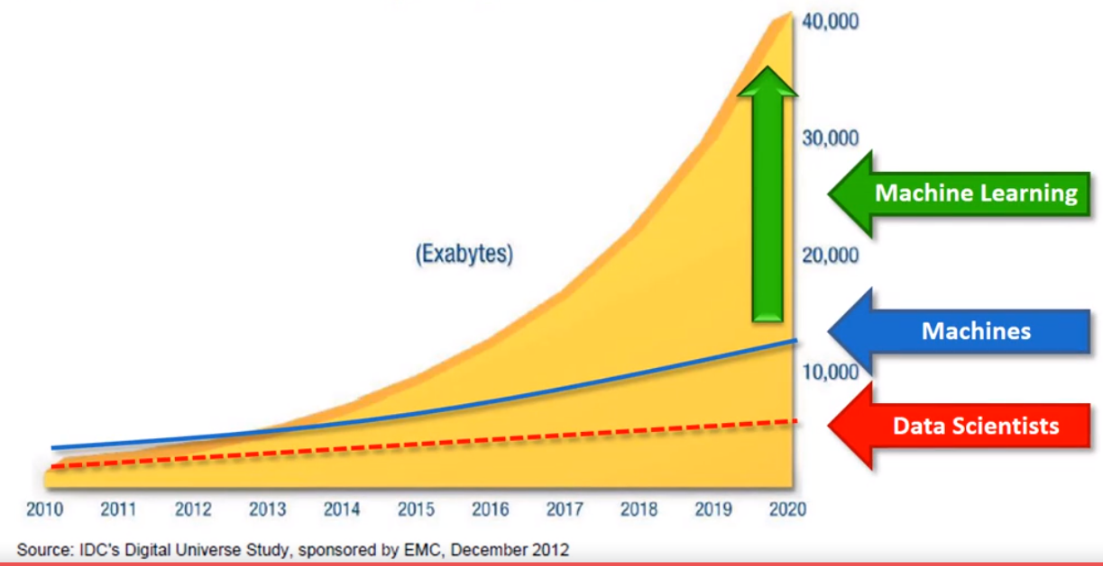
Data: The Driving Force
130 Exabytes till 2005
1200 ExaBytes till 2010
7900 ExaBytes till 2015
40900 ExaBytes till 2020

Slide 8
Why Python
it’s easy to understand.
Packages, Packages everywhere !
Huge Community Support
You can work with all kind of data
MATLAB/R/Octave/Python
MATLAB-Slow, can only be used in prototyping, not open source
R-Open Source, for statistical analysis
it’s not fast and takes more space

Slide 9
Tools and Installation
You can download python from website https://www.python.org/downloads/
At time of this training stable released version is 3.7
I will suggest to use 3.6 for now
But for our purpose we will be using Anaconda distribution.
It is open source distribution for Python and R for DS and ML.
You can download it from website “https://www.anaconda.com/download/”
Right now they are providing 3.7 but you can switch to python 3.6 as well.

Slide 10
A word on Jupyter Notebook
Jupyter Notebook?
Open source web application
Very good in prototyping phase
Individual blocks
Flexible, sharable
Allow python, SQL, R, Julia
Jupyter Basics (refer Notebook)

Slide 11
Python
It is a general purpose programing language.
Python is a high level language.(in terms of CPU time, it is not very effective)
User friendly and easy to interpret.
War of python 2.x vs 3.x(python 3 is around from 2008).
95% data science libraries migrated to 3.x
No support of python 2.x after 2020.
Lets Start some coding.(refer Python Notebook)

Slide 12
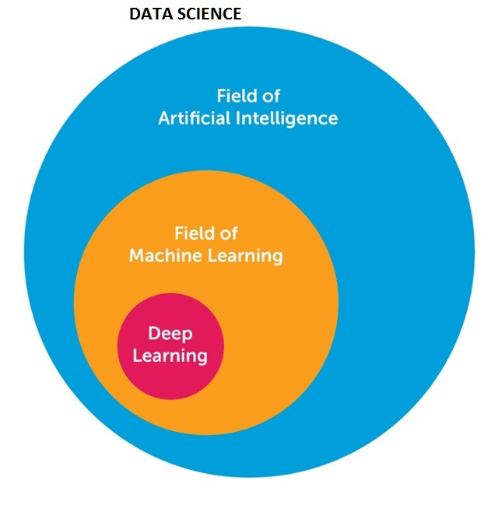
Understanding Different terminologies
UNSUPERVISED
LEARNING
SUPERVISED LEARNING
REINFORCEMENT

Slide 13
Machine learning
Use of data to make a machine make intelligent decision
Machine learning is nothing but to recognize patterns in your data.
According to Arthur Samuel way back in 1959: “[Machine Learning is the] field of study that gives computers the ability to learn without being explicitly programmed.”
An important task of a Machine learning engineer in his/her work life is to extract, process, define, clean, arrange and then understand the data to develop intelligent algorithms.

Slide 14
Data in Machine Learning
Training Data
Independent Variable
Dependent variable
Test Data
Independent Variable
Model will be trained with Training data
Performance will be checked on test data

Slide 15
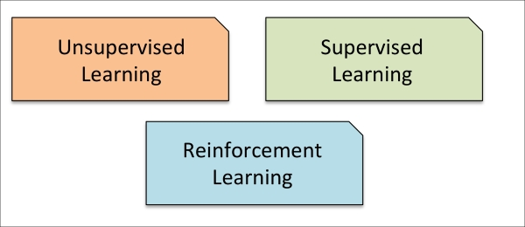
Types Of Machine Learning

Slide 16
Supervised Learning
Ultimate goal is to develop a finely tuned predictor functions.
Supervised machine learning: The program is “trained” on a pre-defined set of “training examples”, which then facilitate its ability to reach an accurate conclusion when given new data.
It is mainly if two types:
Regression
Classification (We will solve problem on this)

Slide 17
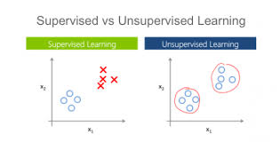
Unsupervised Machine Learning
Unsupervised Learning is a class of Machine Learning techniques to find the patterns in data.
Types of Unsupervised ML
Clustering
Principal Component Analysis (PCA)
Singular-Value Decomposition (SVD)
Data Compression(NN)
Auto encoders
CATS
DOGS
What is it?

Slide 18
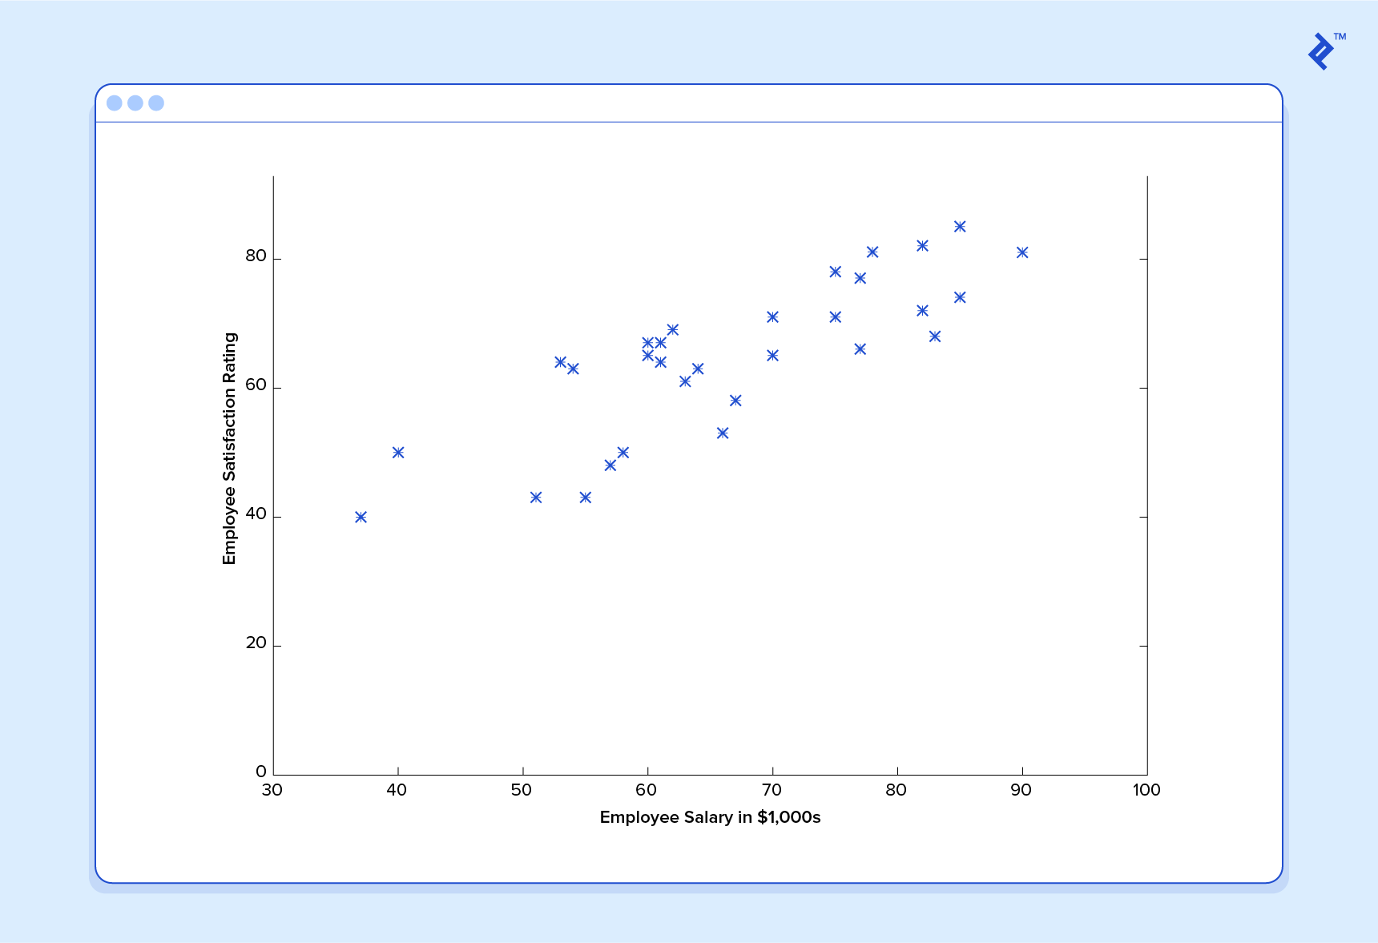
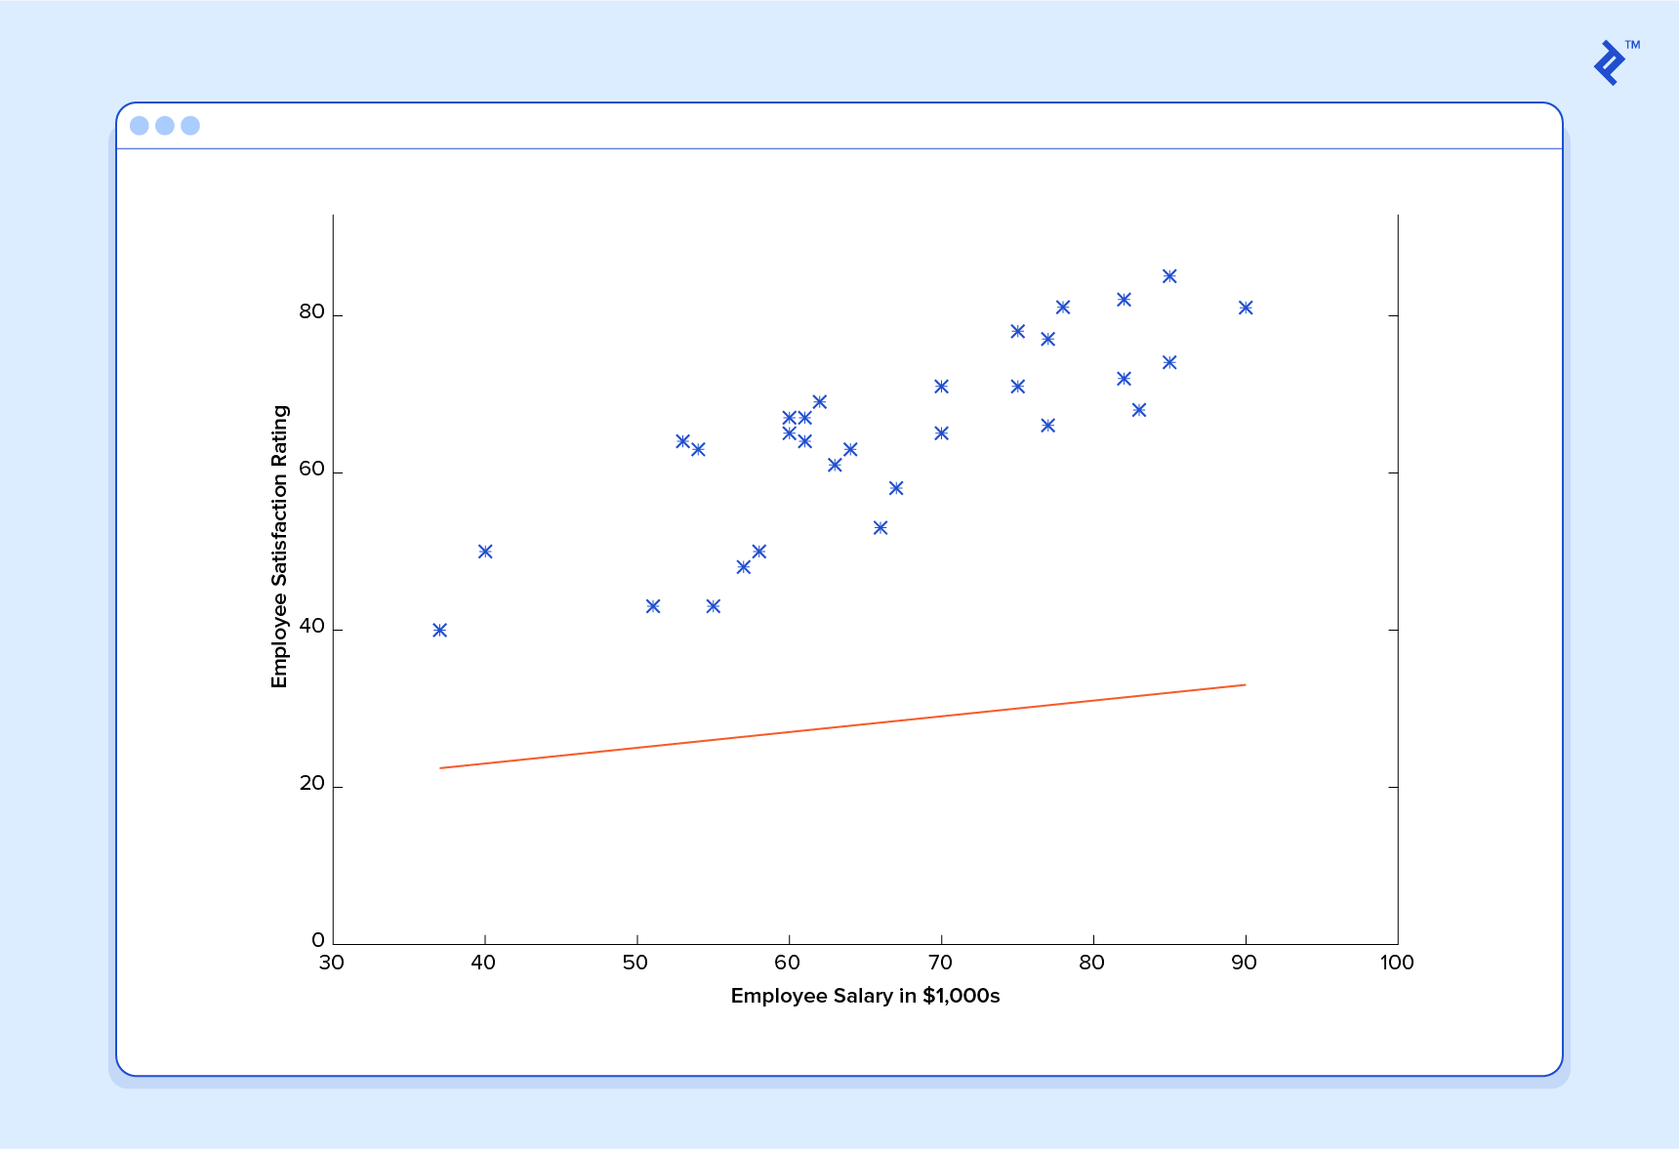
Supervised Machine learning Example(Regression)

Slide 19
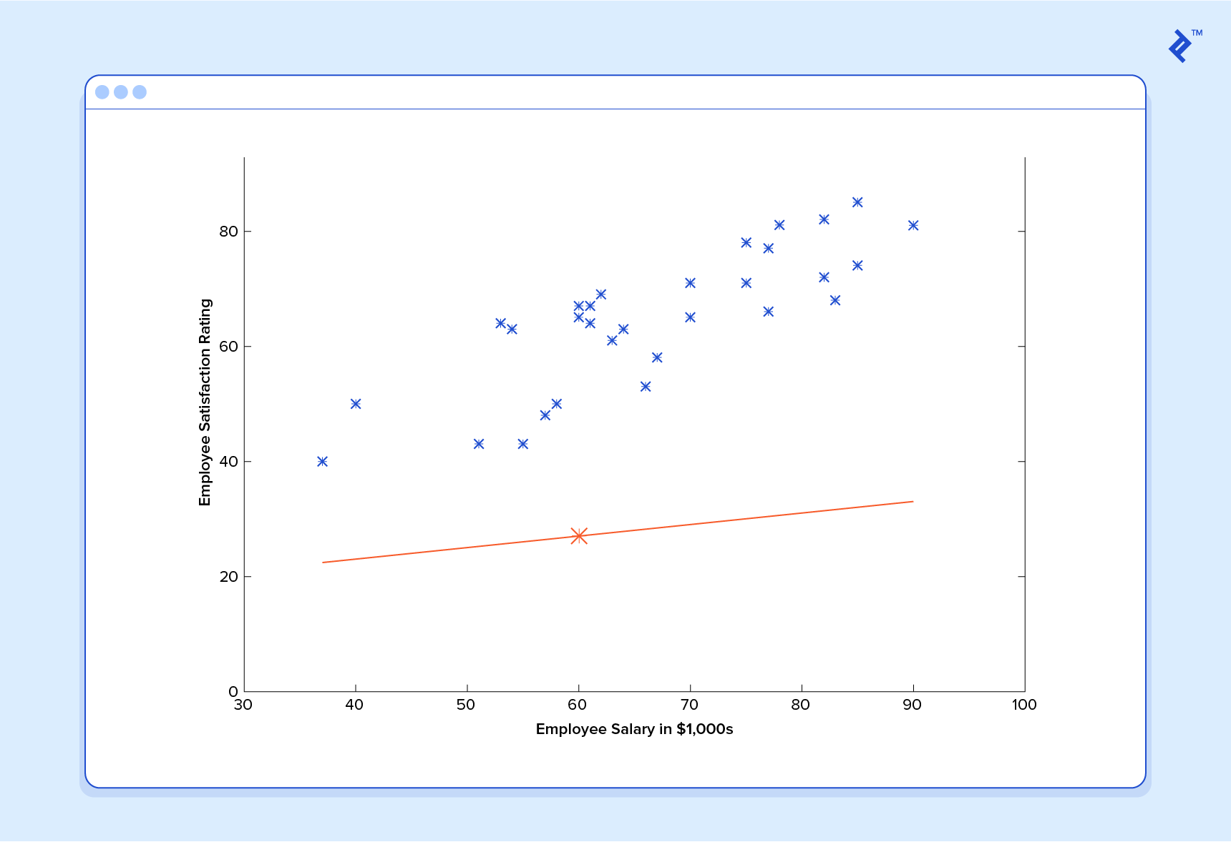
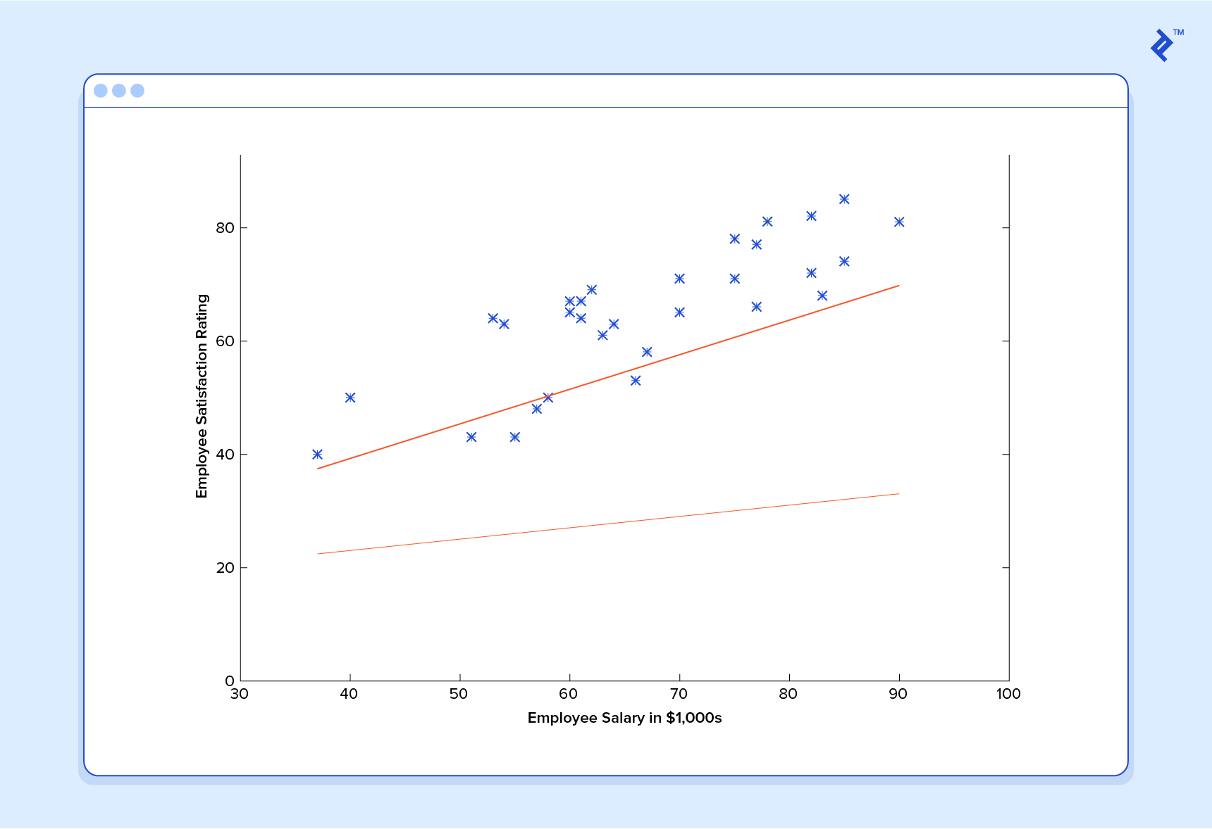
Contd..
Suppose we asked from this predictor function to predict satisfaction index of employee with salary 60k,
And It will give us result as 27, which is totally wrong

Slide 20
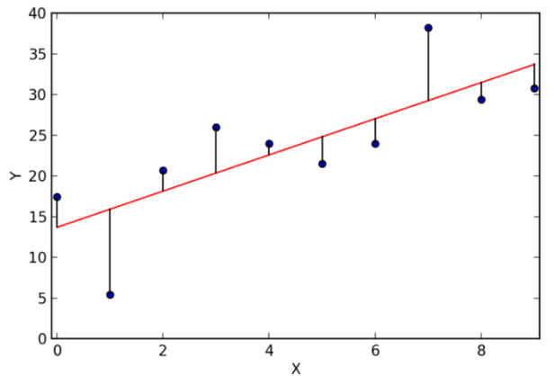
Contd..
Predictor/model will try to reduce total distance to that line.
It can be done many methods but most important is.
>Gradient Descent

Slide 21
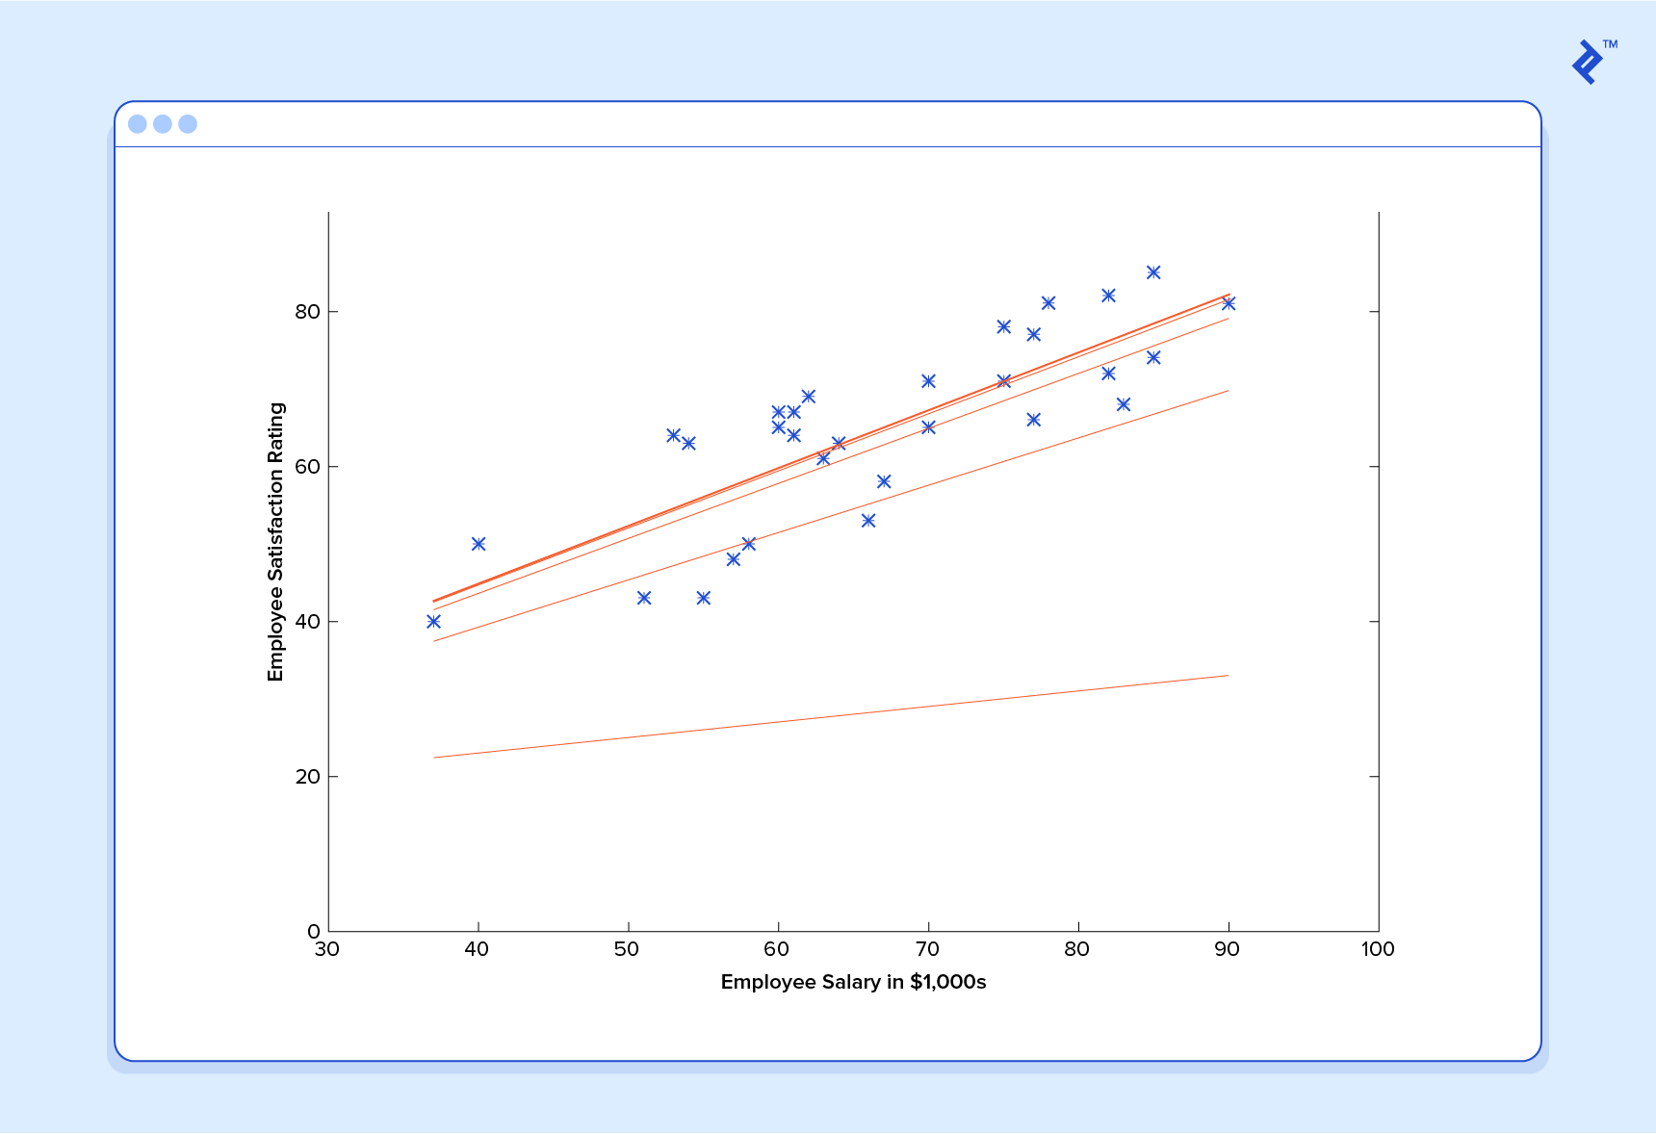
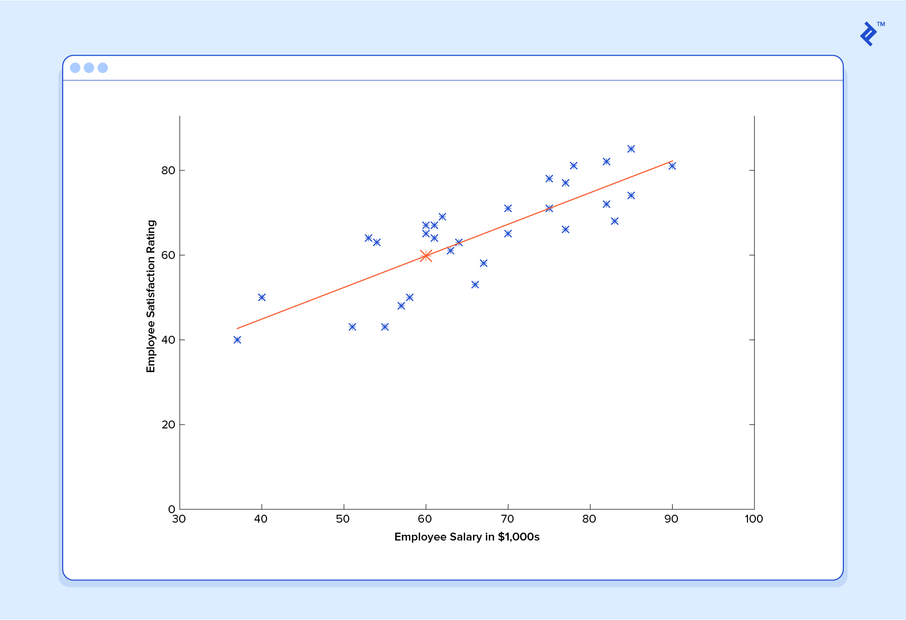
Contd..
Now we asked our predictor to predict value for salary 60k.
And we got result roughly as 60, which is somewhere near to our correct value.

Slide 22
Contd..
This function takes input in four dimensions and has a variety of polynomial terms. Deriving a normal equation for this function is a significant challenge. Many modern machine learning problems take thousands or even millions of dimensions of data to build predictions using hundreds of coefficients

Slide 23
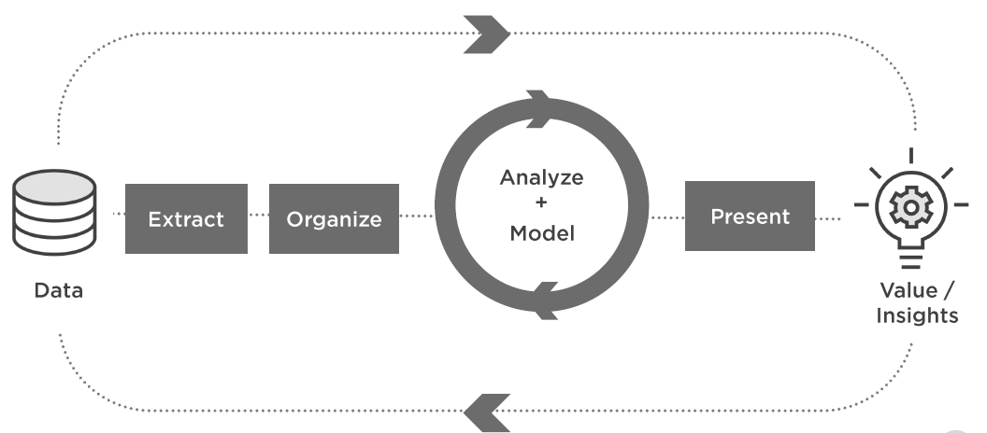
DATA SCIENCE PROJECT CYCLE

Slide 24
Problem Statement
A bank ABC wants to forecast which customer will stay with bank and who will leave the bank. It has extracted all possible details about the customer and wants from you create a model/predictor so that they can use it whenever they want. They will using this model to predict the possibility of a customer of leaving the bank. By knowing these details they will take extra precaution and try to improve customer relationship for those customers.
Files provided: train.csv,test.csv
Features/columns provided:
CustomerId :Unique id of the customers
Surname :Surname of the customers
CreditScore : credit score of the customer( 1 to 1000)
Geography : Geography from which customer belongs
Gender : Gender of customer(Female/Male)
Age :Age of Customer( 1 to 100)
Tenure : Duration from which customer is part of the bank( in years)
Balance: Current balance of the customers
HasCrCard: if customer has credit card from this bank or not(1:yes,0:No)
IsActiveMember : If customer is active member or not(1 :active,0:not active)
EstimatedSalary :Estimated salary of the customer( or income of customer)
Exited : (1:Stayed, 0:left)

Slide 25
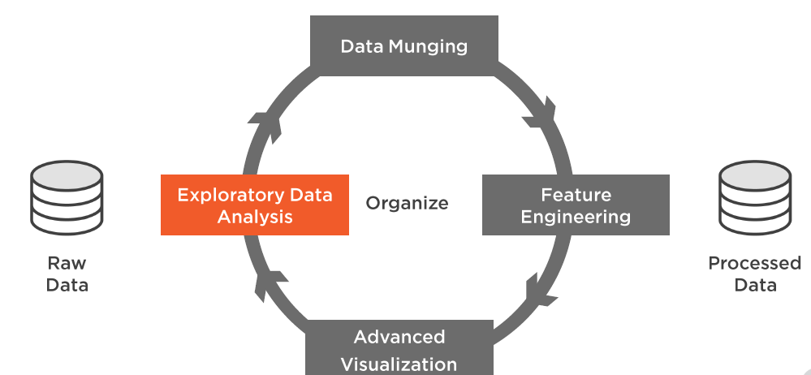
Data Pre processing
Get the dataset
Importing the libraries
Importing the dataset
Data Exploration
Missing data
Outliers Detection
Categorical data
Feature scaling
Splitting data in train and test

Slide 26
Data Exploration
Numerical features
Categorical features
Distributions
grouping

Slide 27
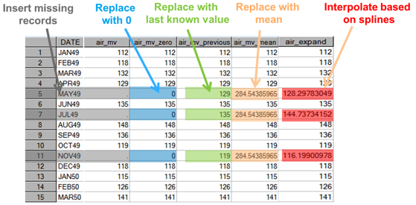
Missing Values
Missing Values
Value not known
Can be represented as NaN
Very common in real world
Non availability of data
Manual data entry mistake
Measuring error
Solution
Deletion
Imputation

Slide 28
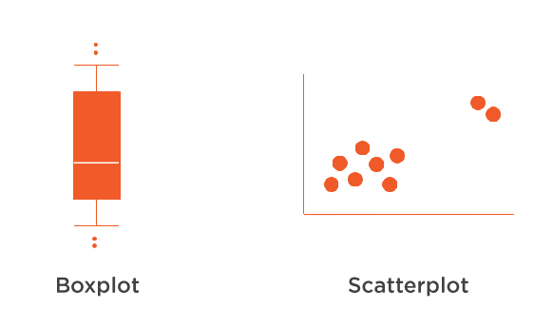
Outliers
Outliers
Different from normal data
Either very low or very high from average behavior of that variable
Source
Data Entry
Natural
Exception
Issue
Biased analysis
Solution
Removal
Transformation
Binning
Imputation

Slide 29
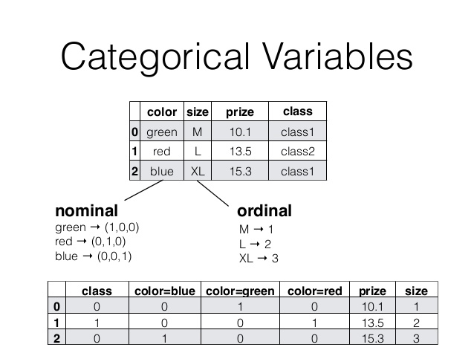
Categorical Features/Data
One Hot Encoding

Slide 30
Feature Engineering
Addition of new features/columns for better prediction
Transforming data to better representative features
It needs great domain expertise to create new features
It needs very depth insight of data to create new features
Don’t create new features as it can back fire, if you inserted correlated feature.

Slide 31
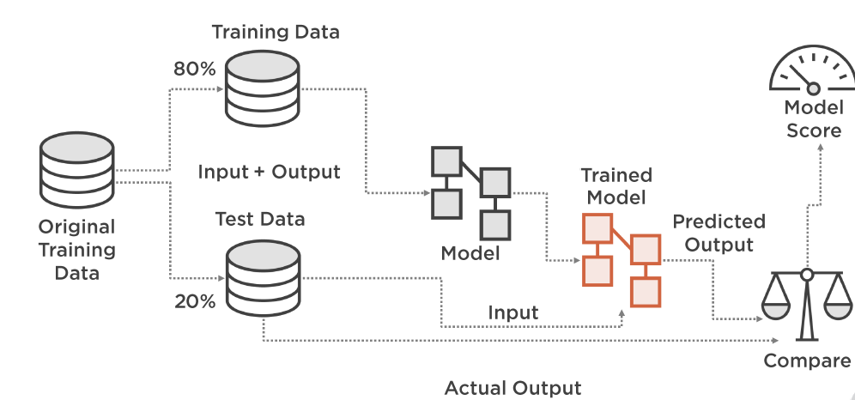
Cross Validation
Cross-validation is a technique for evaluating ML models by training several ML models on subsets of the available input data and evaluating them on the complementary subset of the data

Slide 32
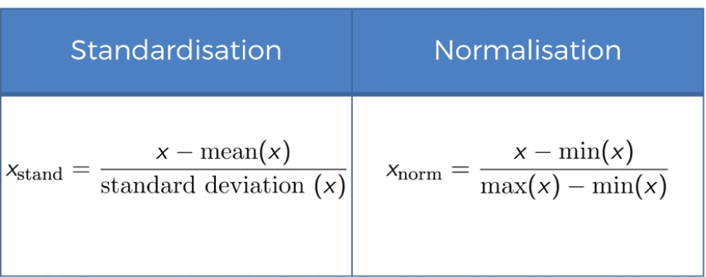
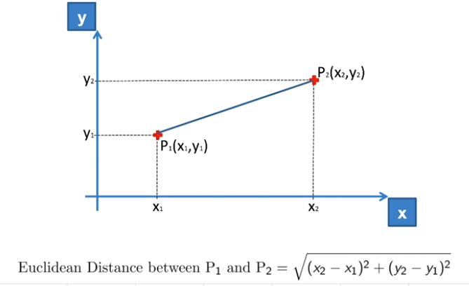
Feature Normalization
Features can be normalized in
mentioned two ways.

Slide 33
Algorithms
Logistic Classifier
K Nearest Neighbors Classifier
Random Forest Classifier
Naive Bayes Classifier
Support Vector Machine Classifier
XG Boost Classifier
CatBoost Classifier

Slide 34
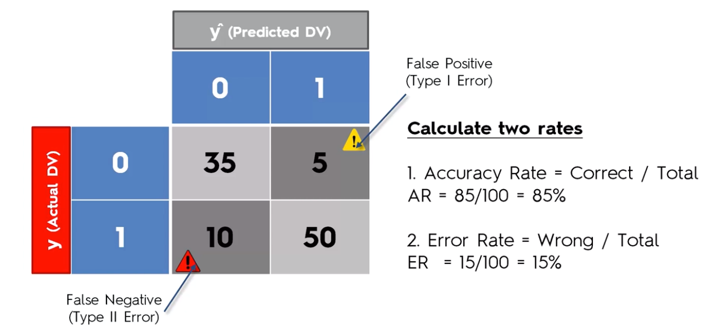
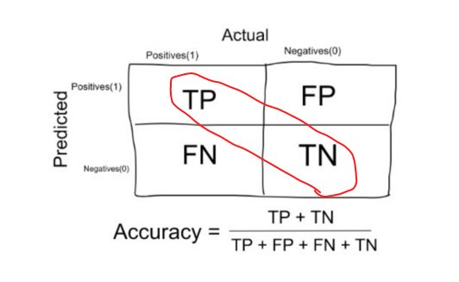
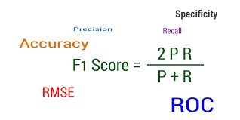
Metrics
These are metrics which rate our model. Using these we can come to conclusion either we need more tuning or we have reached threshold and is it good enough to deploy in production.

Slide 35
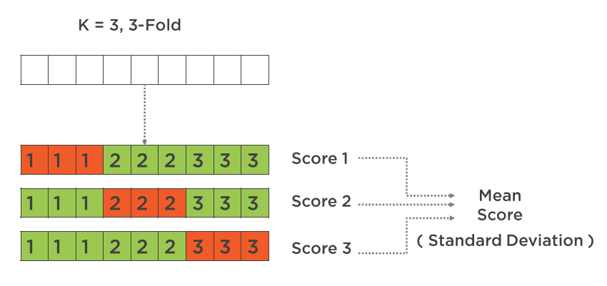
K Fold Cross Validation
This algorithm splits data in K folds.
Training is done on for every sets of data.
Mean of all validation gives more accurate measurement.

Slide 36
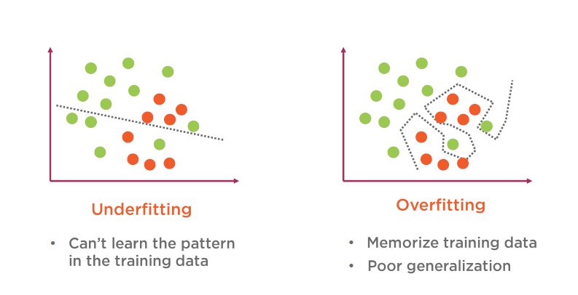
Under Fitting vs Over Fitting

Slide 37
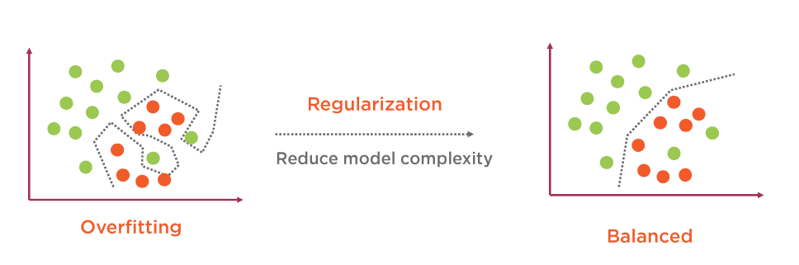
Regularization

Slide 38
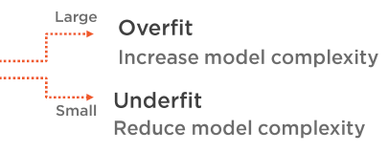

Hyper parameter Tuning
After processing all steps and selecting the model there is a scope of tuning your model a bit more.
It can be done by tuning the parameters which we paas to the model.
LogisticRegression(C=1.0, class_weight=None, dual=False, fit_intercept=True,intercept_scaling=1, max_iter=100, multi_class='ovr', n_jobs=1,penalty='l2', random_state=None, solver='liblinear', tol=0.0001,verbose=0, warm_start=False)

Slide 39


Slide 40
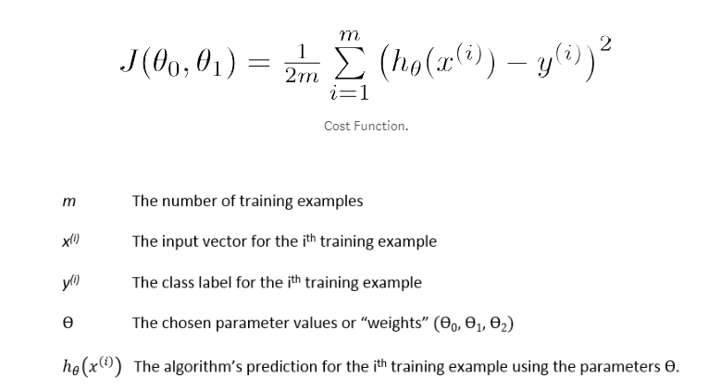
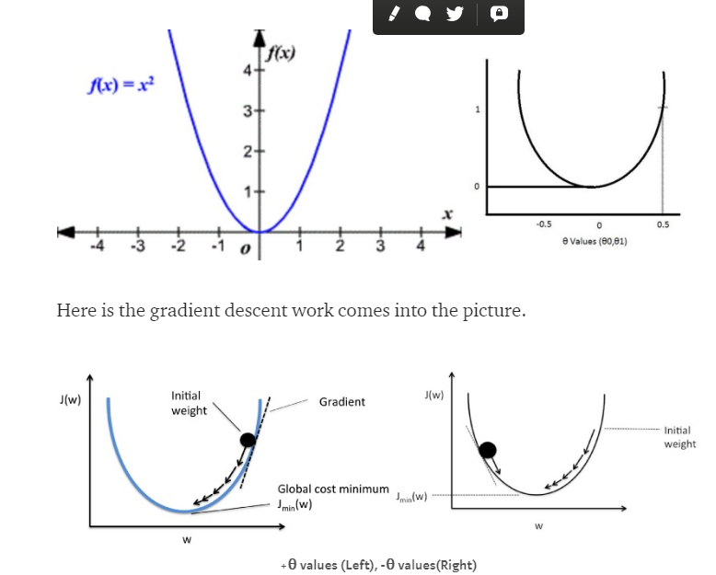
Extra Topic: Gradient Descent

Slide 41
THANK YOU!!!

